Slide 1
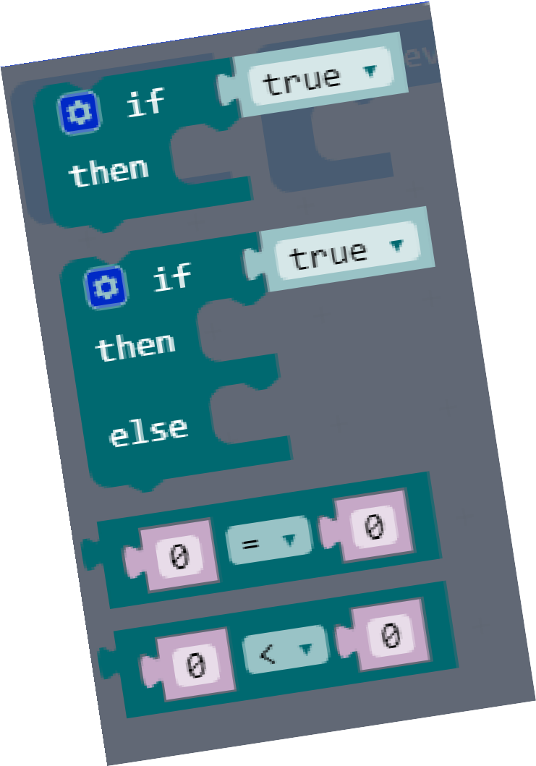
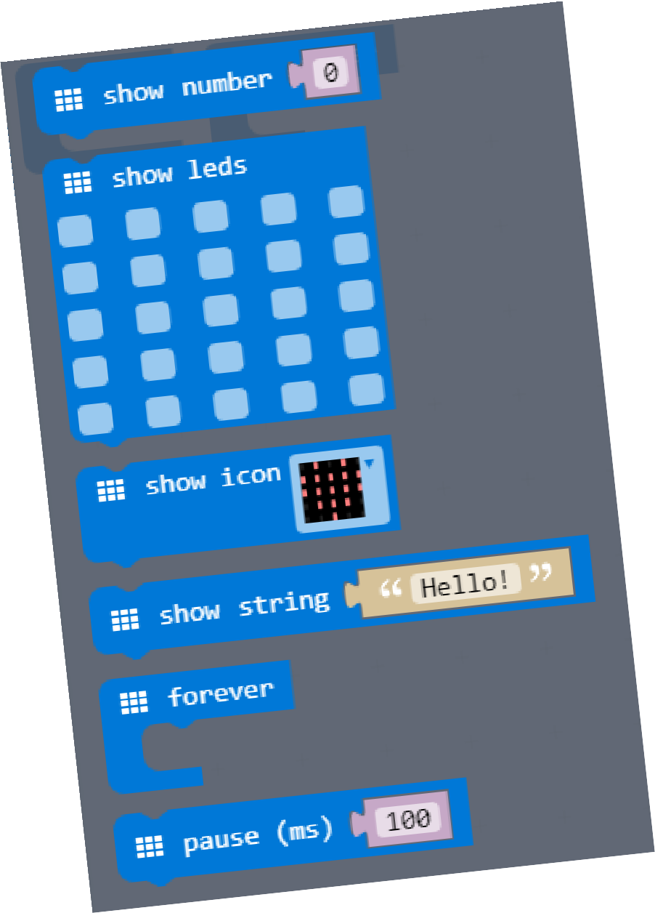
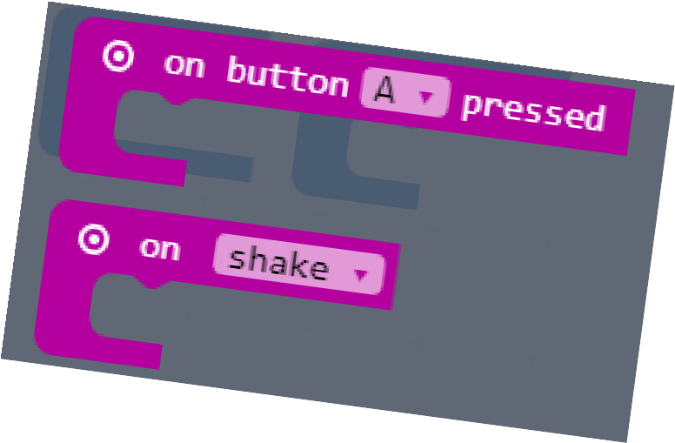
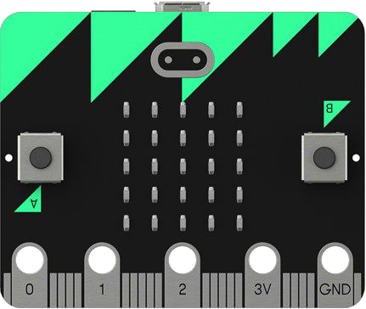


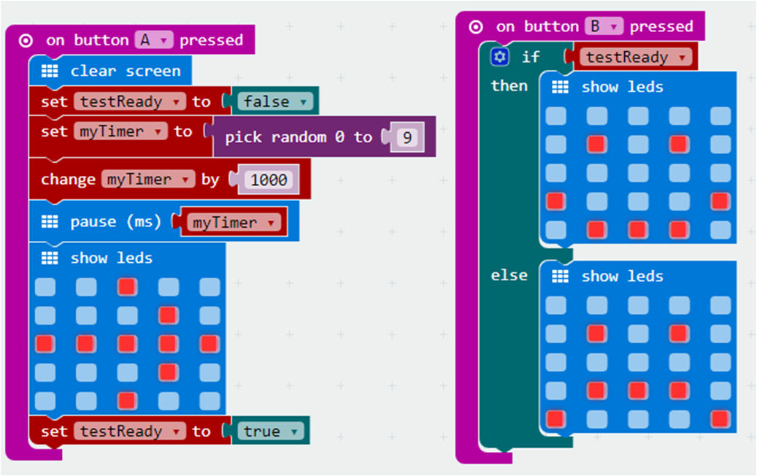
Write an explanation for each of these key terms as you find them out :
variable
abstraction
decomposition
Event handler
pseudocode
Being able to ‘read’ code and systems and understand what they are doing is a vital part of programming. Annotate this image with comments to explain what each part of this application is doing.
Write out some of the Python code for performing specific tasks
Displaying a YES tick on the screen
Making the micro:bit pause (go to sleep) for 200 milliseconds
An If statement to see if button A has been pressed
Creating a variable and storing a value (such as a number) in it
An If statement to test whether two variables match

